Slide 1
Welcome to the Chaffey College New Student Orientation
Presented by the Counseling Department

Slide 2
Outline for New Student Orientation
Getting started at Chaffey
Student Services
MyChaffeyVIEW
Certificate, Associate Degree, and Transfer Requirements
Cost of Attending Chaffey College
Financial Aid
Academic Expectations
Student Success Initiative
Assessment Testing
Time Management
Mindset
Student Educational Planning Workshop
Students who are still enrolled in high school must attend a different orientation. Please let us know if this applies to you!

Slide 3
Getting Started at Chaffey College
Apply for the current term
Always reapply if you do not take classes for one or more semesters (does not include summer)
Attend a New Student Orientation
Take the Assessment Test
Create a Student Educational Plan

Slide 4
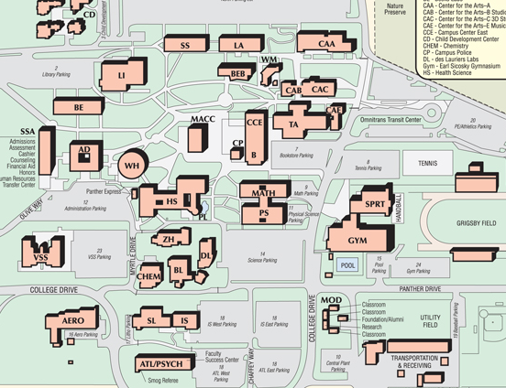
Student Services Some programs and departments you should be familiar with…
Admissions & Records
Athletics
Bookstore
Child Development Center
Counseling/Registration Center
Disability Programs & Services (DPS)
Early Advantage
Extended Opportunity Programs & Services (EOPS)
Financial Aid
Career Center/Student Employment
Health Services
Honors Program
Student Activities
Student Success Centers
Transfer Center
Veteran’s Center

Slide 5
Activate and familiarize yourself with your MyChaffeyVIEW account
1.
3.
www.chaffey.edu
2.
Username: 1st initial of your first name, 1st initial of your last name (lowercased), and your 7 digit ID number
Initial Password: 6 digit birthday

Slide 6
Frequently Asked Questions
How long does each class last?
We are a semester based school
There are two, 18 week sessions per year:
Fall (August – December) and Spring (January – May)
Summer session is optional; it is not required
Our traditional, full term classes will last for the duration of the semester
What types of classes are offered?
Most of our courses are offered onsite
There are also hybrid, online, and fast-track courses
Hybrid: Partially online, partially in class
Fast Track: 8 week classes, there are 2 Sessions (or “Tracks”) during each semester
Where can I take classes?
Example:
We have 3 different campuses
Rancho Cucamonga, Fontana, and Chino
Not all courses & programs are offered at every campus

Slide 7
What will YOU be working towards?
Associate’s Degree
Transferring to a University
Certificate
Major Requirements
Amount of units needed will vary by major
General Education
Major Requirements
Electives (if needed)
Minimum of 60 Degree Applicable Units
Minimum of a 2.0 GPA
General Education
Major Prep Courses
Electives (if needed)
Minimum of 60 Transferable Units
GPA requirements vary by school
Refer to Page 17 for a list of degree and certificate programs
Think about your career goals and research what level of education you will need to reach based off of your chosen profession.

Slide 8
How much does Chaffey College cost?
Enrollment Fee (Tuition) $46.00 per unit
Material Fees Vary by course
Health Service Fee $17.00
Transportation Fee $7.50
Parking Permit $50.00 ($25 for Summer)
Textbooks Vary by course
College Services Fee $8.00 (optional)
1 Unit Course = $46
3 Unit Course 3 x $46 = $138
12 Units (Full Time) 12 x $46 = $552

Slide 9
How can I afford to attend Chaffey?
A majority of our students receive some type of financial aid.
To receive most types of aid you must fill out a FAFSA (Free Application for Federal Student Aid) application and GPA verification by March 2nd
www.fafsa.gov
School Code:001163
Don’t assume you will not qualify for
Financial Aid. Leave eligibility up to the
Department of Education and Financial
Aid to determine.
Examples of Financial Aid Programs:
BOGW (Board of Governors Fee Waiver)
Cal Grants
Federal Pell Grant
Federal Work Study Program
Always consult with the Financial Aid Department regarding any questions you have!

Slide 10
Academic Expectations
Chaffey College Students are required to maintain Satisfactory Academic Progress
Minimum of a 2.0 GPA
Students must successfully complete courses that they are registered for (Avoid grades of D, F, W, I, or NC)
Your financial aid and future registration can be effected by failure to meet these requirements!
Students are expected to attend all classes for the entire length that the course is scheduled

Slide 11
Student Success Initiative
This is an initiative to help California Community College students
successfully complete their educational goals in a timely manner
Requirements of the Student Success Initiative:
Students must have attended a New Student Orientation
Students must have Assessment Test scores on file
Students must have a Counselor Approved Student Educational Plan
Students must be in Good Academic Standing
Students who do not meet these requirements as of Fall 2014 will lose their priority registration

Slide 12
Your next step… Assessment Testing
The Assessment Test is a placement tool to determine your skill level in Math and English
Courses are sequenced, which means you need to take (and pass!) one before you move on to the next
Where you place is where you start!
You have a total of 2 attempts to take the Assessment Test
You must wait a minimum of 3 months to retest

Slide 13
Exemptions to the Assessment Test Reasons why you wouldn’t take the test
“I scored “College Ready” for English and/or Math on the EAP test in high school.”
“I took and passed an AP English and/or Math test with a score of 3 or higher.”
“I successfully completed Math and/or English with a “C” or better at another college.”
Bring EAP results to the Counseling Department and fill out a Prerequisite Validation Form.
Submit official College Board results to Admissions & Records and fill out a Prerequisite Validation Form.
Submit your OFFICIAL transcripts to Admissions & Records.
Once your transcripts are submitted, you will need to make an appointment for an External Transcript Evaluation or fill out a Prerequisite Validation Form
You may not use assessment test results from another college.
A math or English class must have been taken and passed in order to be exempt from the test.

Slide 14
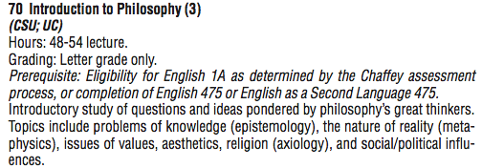
What if I’m not planning on taking a math or English course?
Do I still take the assessment?
YES!
Many courses have English or Math prerequisites
Example: This Introduction to Philosophy course has a prerequisite of being eligible for English 1A
What if the course I want to take does not have a math or English prerequisite?
In order to ensure that your registration date will not be penalized, you will need assessment test scores to fulfill the requirements of the Student Success Initiative

Slide 15
English Sequence
ENGLISH 1A
Composition
(CSU and UC transferable)
This sequence is on page 16 in your packet.
You will leave the assessment center with your results...
You must take, and successfully complete that course before moving on to the next class.
Example:
If you place into English 575, you must register for that class, pass it with a C or better, and the following semester you will be eligible to register for the next course, English 475.
If you’re planning on getting an Associate’s Degree from Chaffey, or if you are transferring, you will need to take and successfully complete English 1A.
ESL 475
Fundamentals of Composition for ESL students
ENGLISH 475
Fundamentals of College Reading & Writing
(not transferable)
ENGLISH 575
Introduction to College Reading & Writing
(not degree applicable)
Retake the assessment test
ENGLISH 675
Preparation for College Reading & Writing
(Not degree applicable)

Slide 16
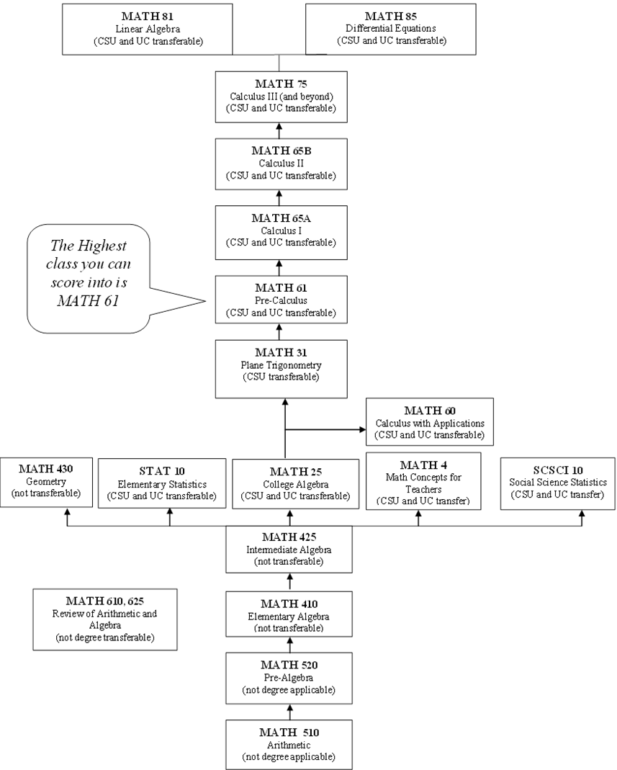
Math Sequence
This sequence is on page 16 in your packet.
If you feel that you would benefit from a review course after you have taken your assessment test or you are not satisfied with your results, you can register for Math 610 or 625 before taking the test again
Math-610 will review Arithmetic and Pre-Algebra
Math-625 will review of Elementary and Intermediate Algebra
Minimum requirement for Transfer
Minimum requirement for an Associate’s Degree

Slide 17
Be sure to study and review before you test!
Use the practice questions in your booklet (Pages 9-15)
Utilize: www.accuplacer.org
Bring a picture ID to your testing appointment
You are not allowed to use a calculator
You will sign up for an appointment at the end of this orientation
You can take the assessment at any campus. To make an appointment for a different campus, call their Counseling Department or schedule on the Chaffey College website: www.chaffey.edu.
Rancho:(909) 652-6200 Chino:(909) 652-8000 Fontana:(909) 652-7400
If you’re taking the test at the Rancho campus, you will meet in the Counseling Office at the time of your appointment and wait to be called in.

Slide 18
Time Management Do not take on more than you can handle!
How much time should I expect to spend studying?
Is coming to school full time right for me?
Can I still work while coming to school?
Commitment of Time
1 unit = 1 hour of classroom time per week
1 unit = 2 hours of study time per week
3 units= 3 hours of classroom time per week
3 units = 6 hours of study time ( 3x2 =6)
12 Units= 12 hours of classroom time
24 hours of study time = 36 hours
How many classes should I take?
Things to consider when deciding how many units to take:
Work
Sleeping
Commuting
Eating
Grooming
Health
Family
Friends
Relationships

Slide 19
Mindset
Now that we’ve discussed the time you will need to commit to school, lets discuss how you can be successful while attending Chaffey College…
Mindsets are beliefs about yourself and your most basic qualities.
Think about your intelligence, your talents, your personality…
Are these qualities simply fixed traits, carved in stone and unable to change? Or are they things you have control over?
There are 2 types of mindsets…

Slide 20
Fixed Mindset:
People with a fixed mindset feel that talents and abilities are set in stone-either you have them or you don't. These individuals feel the need to prove themselves to others by trying to look smart and talented at all costs.
Growth Mindset:
People with this mindset believe that talents and abilities can be changed and improved with dedication and learning from mistakes. They do not compare their victories or failures to anyone else, but take lessons away from the experiences instead.
How you can relate this to your
educational journey:
Embrace challenges
Focus on the act of learning
Find inspiration in the success of others
Realize that you have the ability to take control over your own attitude and mindset
Learn from past failures; use them to make changes in the future

Slide 21
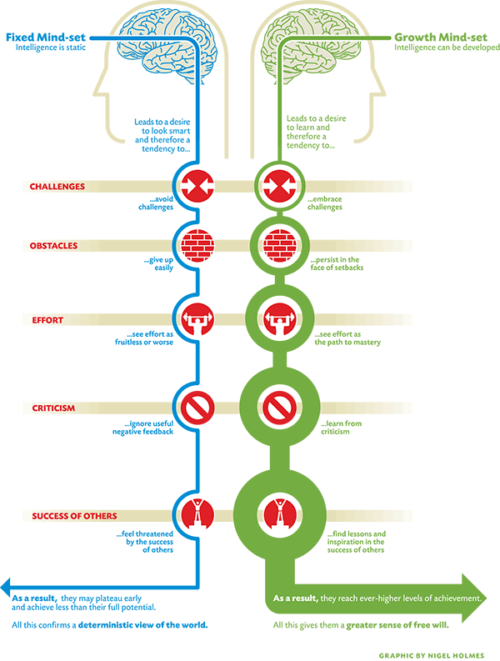
Begin with the end in mind… Remember: This is YOUR future!
Strive to have a Growth Mindset
Ask questions if you are unsure about anything
Seek individuals that can help motivate you
Utilize resources available to you on campus

Slide 22
What do I do after I take my assessment?
We strive for our students to learn the benefits of having a growth mindset and to find joy in their educational journeys. Let’s discuss the next steps on your road to success…
You will need an Student Educational Plan (SEP)
What is an SEP?
A SEP is a roadmap of the classes you will need to take each
semester in order to complete your individual goal.
How can I get an SEP?
When you leave your assessment appointment, you will
make an appointment for a Student Educational
Planning Workshop at the front desk in the
Counseling Department

Slide 23
What will I do during this workshop?
You will be in a group of students working with a counselor and counselor apprentice to review requirements and information about courses that you will need to complete your goal.
The workshop is 2 ½ hours long
Please make arrangements to be on time
Come prepared to work!
You will be receiving a wealth of knowledge and tools to help you choose appropriate classes.
Have your MyChaffeyVIEW account set up and activated BEFORE you arrive
You will not be registering for courses in this workshop

Slide 24
What should you do next?
Make an appointment for your assessment
Log on and activate your MyChaffeyVIEW account
Don’t leave today without knowing your Student ID number
Complete your FAFSA
After completing the assessment…
Make an appointment for an Educational Planning Workshop at the front desk in the Counseling Department
If you need help registering for courses before your workshop appointment, visit the Counseling Department or Registration Center
Questions?

