Slide 1
Welcome to Chaffey College’s Graduating Senior Early Assessment and Counseling

Slide 2
What will I learn today?
The components of the Senior Early Assessment Program
Financial Aid Information
AB540
Assessment
ME 1st Program
EAP Results
Extended Opportunity Program & Services (EOPS)
Disabilities Program & Services (DPS)
Counseling Session

Slide 3
Senior Early Assessment SU/FA 2014
Graduating high school students will be granted “privileged” registration to enroll for the Summer/Fall 2014 semester.
In order to take advantage of this opportunity, you MUST complete all 4 steps of this program on the dates/time designated.
Attend the New Student Information Session at your high school.
Complete the Application Workshop
Complete the Assessment Test.
Attend the Counseling Session.

Slide 4
How much does Chaffey cost?
FEES for Fall 2014 AMOUNT
Regular Enrollment Fee $46.00 per unit*
Health Service Fee $17.00
College Services $8.00
Material charges (if applicable) Varies – Check schedule
Parking Permit $50 Automobile
$20 Motorcycle
Summer service fees are reduced,
see summer schedule of classes for details
Notes:
See your summer schedule of classes for reduction of fees in Summer

Slide 5
How can I afford to attend Chaffey College?
Approximately 60% of Chaffey College’s student population receives some form of financial aid or BOGW fee waiver
Student aid includes:
Board of Governor’s Fee waivers - Waives tuition costs
Grants – Pell Grants, Cal Grants (Complete FAFSA and GPA verification by March 2nd), etc.
Work-Study Aid – Money earned by the student as payment for a job on or off campus
Notes:
What percentage of financial aid students get the BOGW? Get stat from financial aid

Slide 6
Eligibility for Financial Aid?
Have Financial Need
Estimated Family Contribution (EFC)
Educational Requirements
High School Diploma, GED
Enroll as a regular student/eligible program
Legal/other requirements
Be a citizen or eligible non-citizen
Males: register for Selective Service (18-25)
Be making Satisfactory Academic Progress (SAP) as defined by Chaffey College Financial Aid Policy

Slide 7
How to apply for Financial Aid
To apply for most types of aid, students must complete the Free Application for Federal Student Aid (FAFSA) and GPA verification by March 2nd.
The FAFSA is available on-line at www.fafsa.ed.gov
The GPA Verification can be electronically sent to the California Student Aid Commission by your high school counselor ( Talk to your HS Counselor)
Be sure to include Chaffey College’s school code 001163 so that your FAFSA information is sent to us electronically by the Department of Education
If you have any questions regarding Financial Aid, please visit the website at www.chaffey.edu/finaid
*You will need information from you and your parent’s 2013 income taxes to complete the application for 2014-2015*

Slide 8
For those who Fall Under AB540:
AB540 is a California Law passed in 2001
that allows qualified undocumented students to pay resident fees in California’s public colleges and
universities.
A student who qualifies for AB540 will be exempt from paying the out-of-state tuition fee and will pay the $46 per unit enrollment fee by completing a Non-Resident Tuition Exemption Request
To apply for financial aid submit an application at www.caldreamact.org
Eligibility Requirements:
High School attendance in California for three or more years
Graduation from a California high school (or equivalent)
Completion of the AB540 Affidavit
Notes:
Undocumented students can now apply for financial aid. The website is www.caldreamact.org This application is similar to the fafsa…

Slide 9
What is the Assessment test?
The Assessment Test is a computerized placement tool to determine your skill level in Math and English/Reading.
The Assessment test is important, because where you place is where you start! (You don’t want to take a class that is too easy or too difficult)
Assessment gives you 2 placement requirements in English/Reading and Math.
You are required to begin where you placed on the test.
Courses are sequenced, so you are not able to take more than one course at a time in each sequence.
Notes:
1. Mention that students are only allowed 1 re-test after 3 months

Slide 10
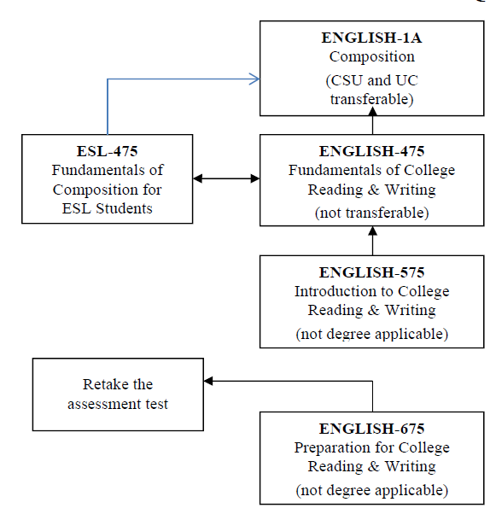
English Course Sequence
ENGLISH-1A
Composition
(CSU and UC)
Transferable

Slide 11
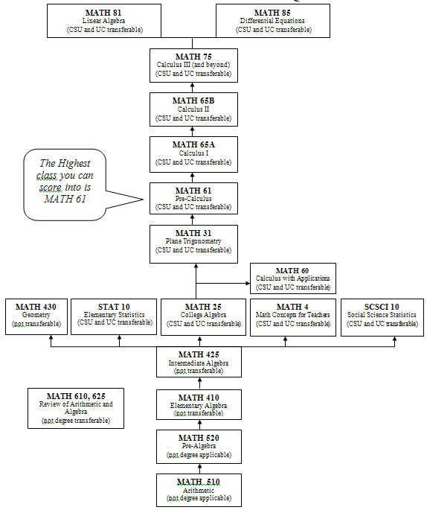
Math Course Sequence
STAT 10
Elementary Statistics
(CSU & UC)
MATH 25
College Algebra
(CSU & UC)
SCSCI 10
Statistics
(CSU & UC)

Slide 12
Assessment Testing Information Cont…
You have a total of 2 attempts to take the Assessment Test.
You must wait a minimum of 3 months from the initial test date to re-test.
Math 610 is a (non-credit) course designed to aid students who test in Math 510 or Math 520
Math 625 is a (non-credit) course designed to aid students who test in Math 410 or Math 425

Slide 13
Assessment Testing Information Cont…
You can take a sample test by going to:
www.chaffey.edu/counseling/assessment
or
www.collegeboard.com/students/testing/accuplacer
There are sample test questions in your booklet.
No calculators allowed for the Math portion of the assessment test. (Please review basic math, including fractions and percentages PRIOR to testing).
Don’t forget to bring a picture ID when you test.
Please take this test seriously!
Notes:
High school ID is ok. Anything that has your name and picture will work.

Slide 14
ME 1st
Is a special program designed to help new students start college right.
Gives students an opportunity to receive privileged registration opportunities for 3 semesters if you earn an eligible assessment/placement recommendation of English 475 and Math 410.

Slide 15
ME 1st Benefits
1. Privileged registration for 3 semesters
2. Comprehensive educational planning session with a counselor
3. Completion of key degree requirements at the beginning of their college coursework sequences

Slide 16
Early Assessment Program
The Early Assessment Program (EAP) measures students college-level readiness for English and Math in your junior year of high school during STAR testing.
If you took the EAP Test you will receive a copy of your results along with your STAR results during your Senior year.

Slide 17
EAP Test
If you took the EAP Test during
STAR testing, go to www.collegeEAP.org
to download your results. If you received “college ready”, please bring your EAP results to the assessment test session so that we can waive your assessment test in either English and/or math.

Slide 18
EAP Scores
“College Ready” on the EAP test for English EXEMPTS you from the Chaffey College Assessment and places you into ENGL 1A.
“College Ready” on the EAP test for math EXEMPTS you from the Chaffey College Assessment and places you into Math 25.
If you scored “Conditionally Ready” for math, then you need to complete a math course your senior year in high school that has a prerequisite of Alg. 2 and pass with a C or better. Turn in your official high school transcripts to Admissions and Records. Then bring your EAP results to the Counseling Department to clear the prerequisite to be eligible for MATH-25.
If you scored “Conditionally Ready” for English and completed Expository Reading and Writing Curriculum (ERWC) at your high school and pass with a C or better (C- does not count). Turn in your official high school transcripts to Admissions and Records. Then bring your EAP results to the Counseling Department to clear the prerequisite to be eligible for ENGL-1A.

Slide 19
What is Extended Opportunities Programs & Services (EOPS)?
EOPS is a state funded program established in 1969
Supports qualified students whose educational and socioeconomic backgrounds might prevent them from successfully attending college
The mission of EOPS is to assist students to succeed in their academic goal to obtain a Certificate, Associate Degree, and/or transfer to a university
Ensures student retention

Slide 20
Services offered through EOPS:
Counseling: academic & limited personal counseling
Priority registration every semester
Orientation to college classes
Cultural awareness activities
Book service to assist in purchasing textbooks
Transportation assistance
Foster youth specialized counseling services
www.chaffey.edu/eops
Phone (909) 652-6349 (Rancho Campus)

Slide 21
Eligibility Requirements for EOPS:
Be a high school graduate from the current school year
Qualify for a BOG (fee waiver) type A or B as determined by the Financial Aid Office. Effective January 1st, 2013 AB540 students will be eligible for a Board of Governors Fee Waiver (BOG). For more information, visit https://dream.csac.ca.gov/
Meet one of the following EOPS criteria:
Have a GPA below 2.5 in high school
Have taken the Chaffey College assessment test and scored into remedial courses:
ENGL 675, 575, or 475
MATH 510, 520, or 410
Have completed remedial coursework or English as a Second Language (ESL) classes in high school
Are or have been an Emancipated Minor/Foster Youth
www.chaffey.edu/eops
Phone (909) 652-6349 (Rancho Campus)

Slide 22
What is Disabilities Programs & Services (DPS)?
DPS is a state funded program
Supports services to verifiable physical, psychological, or learning disabled students
Offers academic/vocational counseling with individual educational planning
Assists in providing equal access to education for disabled students
Separate application/acceptance into program required

Slide 23
Services offered through DPS:
Academic counseling
Assistive technology
On-campus transportation
Priority registration
Adaptive equipment
Test taking facility
http://www.chaffey.edu/dps
Phone (909) 652-6379

Slide 24
What to expect from a Counseling meeting?
Review assessment results
Discuss general education, major programs, and certificates
Abbreviated Ed. Plan (counselors do not register you in your classes)
How you register for your classes on My ChaffeyVIEW
How to pay your fees
Provide information on student services that are available for your success!
Notes:
Explain how things are different from high school to college. In HS your counselors pick and register you for your classes, in college counselors suggest classes to take and you will decide when and how they fit in your schedule and you will register independently for your classes online at MyChaffeyView. Describe what MyChaffeyView is.

Slide 25
What do you have to do now?
Apply for financial aid by March 2nd at www.fafsa.ed.gov
Check with your Career Tech/Counselor when Chaffey will be here to provide an application workshop, assessment test, and counseling session
Look over assessment practice questions so you are ready for the test
Take the Assessment Test at your high school.
Attend the Counseling Session
If under the age of 18 at your registration date, please make sure to turn in a Minor Emergency form to Admission and Records.

Slide 26
Take Advantage of this Opportunity
By preparing early and completing all 4 steps at your high school you will receive:
Privileged registration for Summer/Fall 2014
You will have the best selection of classes available to new students!

Slide 27
Congratulations
Class of 2014
See you soon!

